Slide 1


Robust d-wave superconductivity from the Su-Schrieffer-Heeger-Hubbard model: possible route to high-temperature superconductivity
Hong Yao
Institute for Advanced Study (IAS), Tsinghua University
arXiv:2022.xxxxx
?Acknowledgement:
Hao-Xin Wang
(Tsinghua)
Yi-Fan Jiang
(ShanghaiTech University)
CPS Fall Meeting, 2022/11/19

Slide 2
Outline

Slide 3
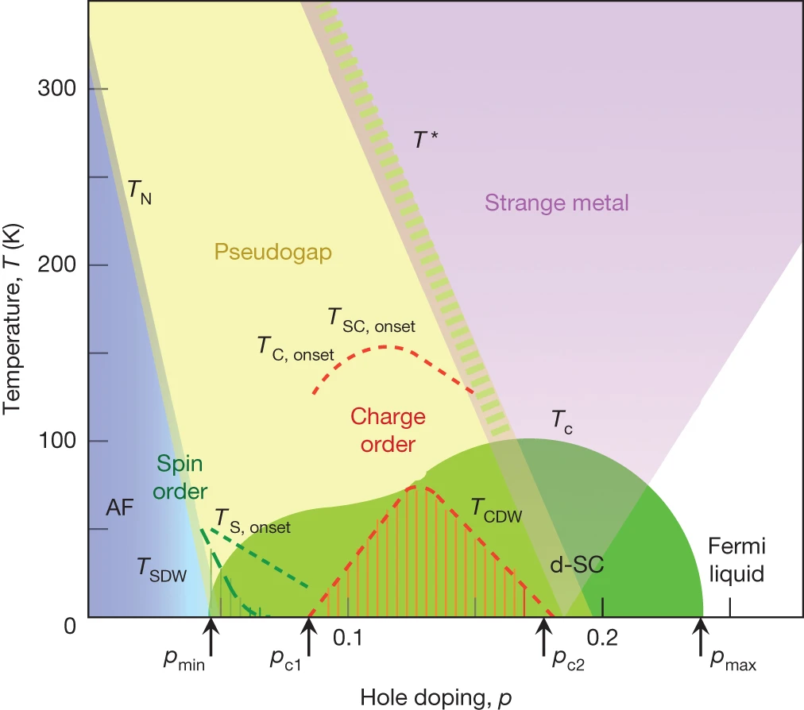
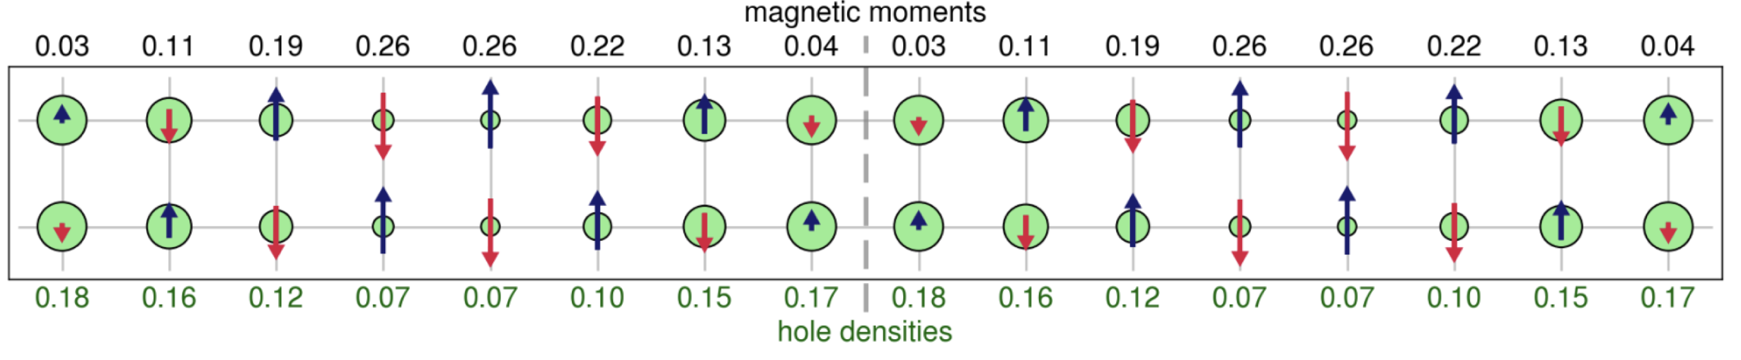
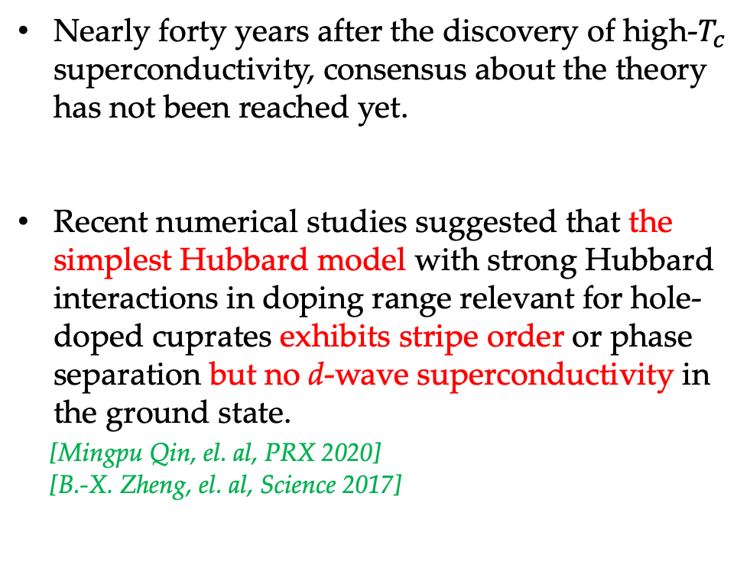
The road to the microscopic mechanism for d-wave superconductivity
Nearly forty years after the discovery of high-$T_{c}$ superconductivity, consensus about the theory has not been reached yet.
Recent numerical studies suggested that the simplest Hubbard model with strong Hubbard interactions in doping range relevant for hole-doped cuprates exhibits stripe order or phase separation but no d-wave superconductivity in the ground state.
[Mingpu Qin, el. al, PRX 2020]
[B.-X. Zheng, el. al, Science 2017]
Cuprate phase diagram
[B. Keimer, et. al, Nature 2015]
Notes:
It has been nearly forty years since the experimental discovery of high-temperature superconductivity. [J. G. Benordz and K. A. Muller, 1986]

Slide 4
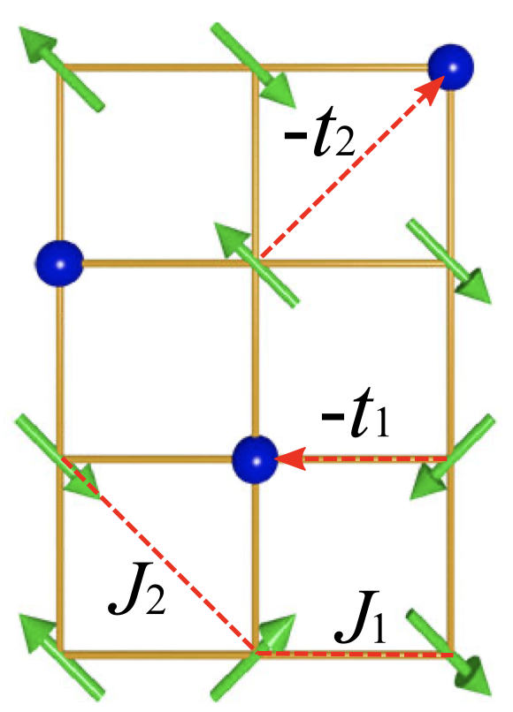
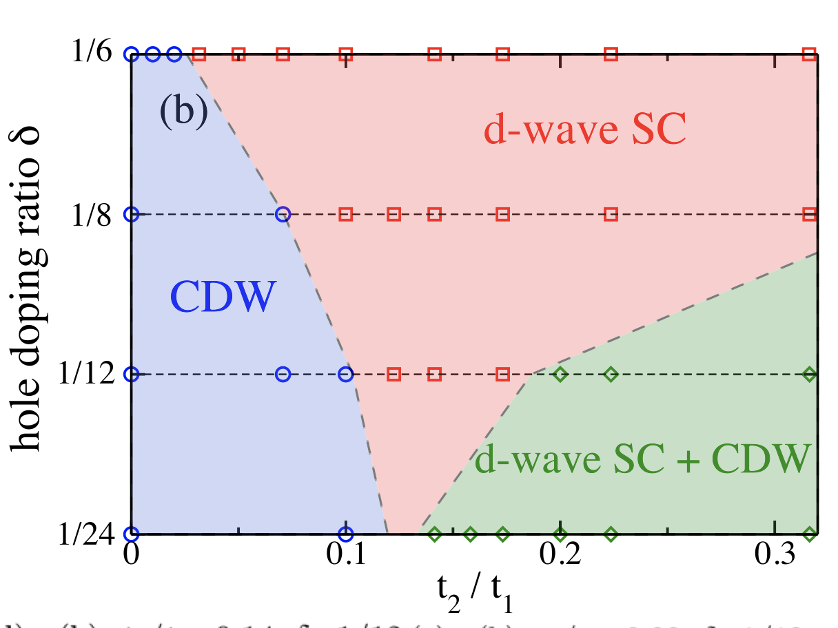
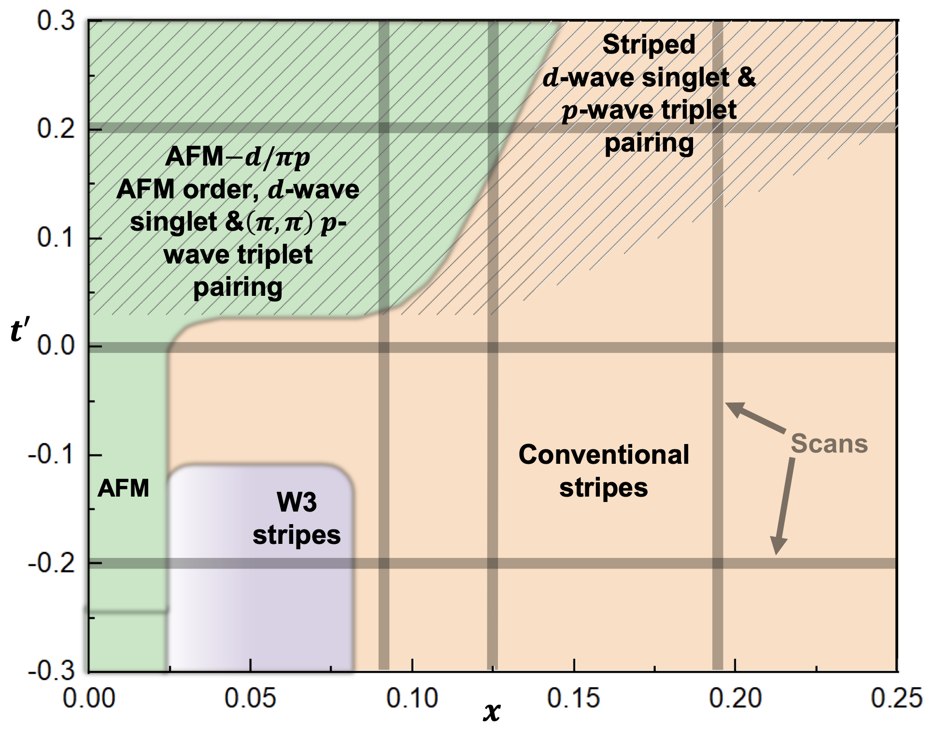
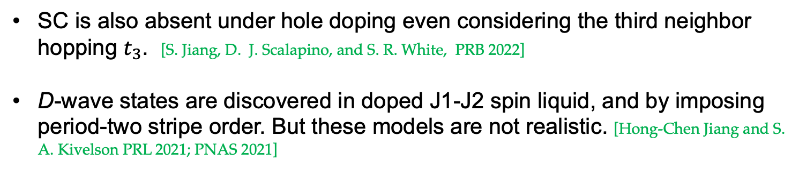
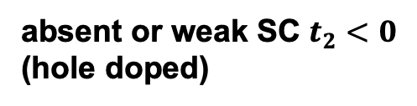
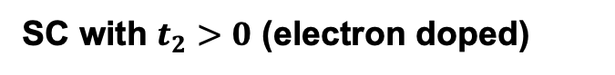

What more is needed beyond the Hubbard model?
The next nearest neighbor hopping $t_{2}$
SC with $t_{2}>0$ (electron doped)
absent or weak SC $t_{2}<0$ (hole doped)
D. N. Sheng, et. al PRL 2021
S. Jiang, D. J. Scalapino, and S. R. White, PNAS 2021
SC is also absent under hole doping even considering the third neighbor hopping $t_{3}$. [S. Jiang, D. J. Scalapino, and S. R. White, PRB 2022]
D-wave states are discovered in doped J1-J2 spin liquid, and by imposing period-two stripe order. But these models are not realistic. [Hong-Chen Jiang and S. A. Kivelson PRL 2021; PNAS 2021]
Notes:
Relevent work for t2, Corboz iPEPS PRB 100, 195141

Slide 5
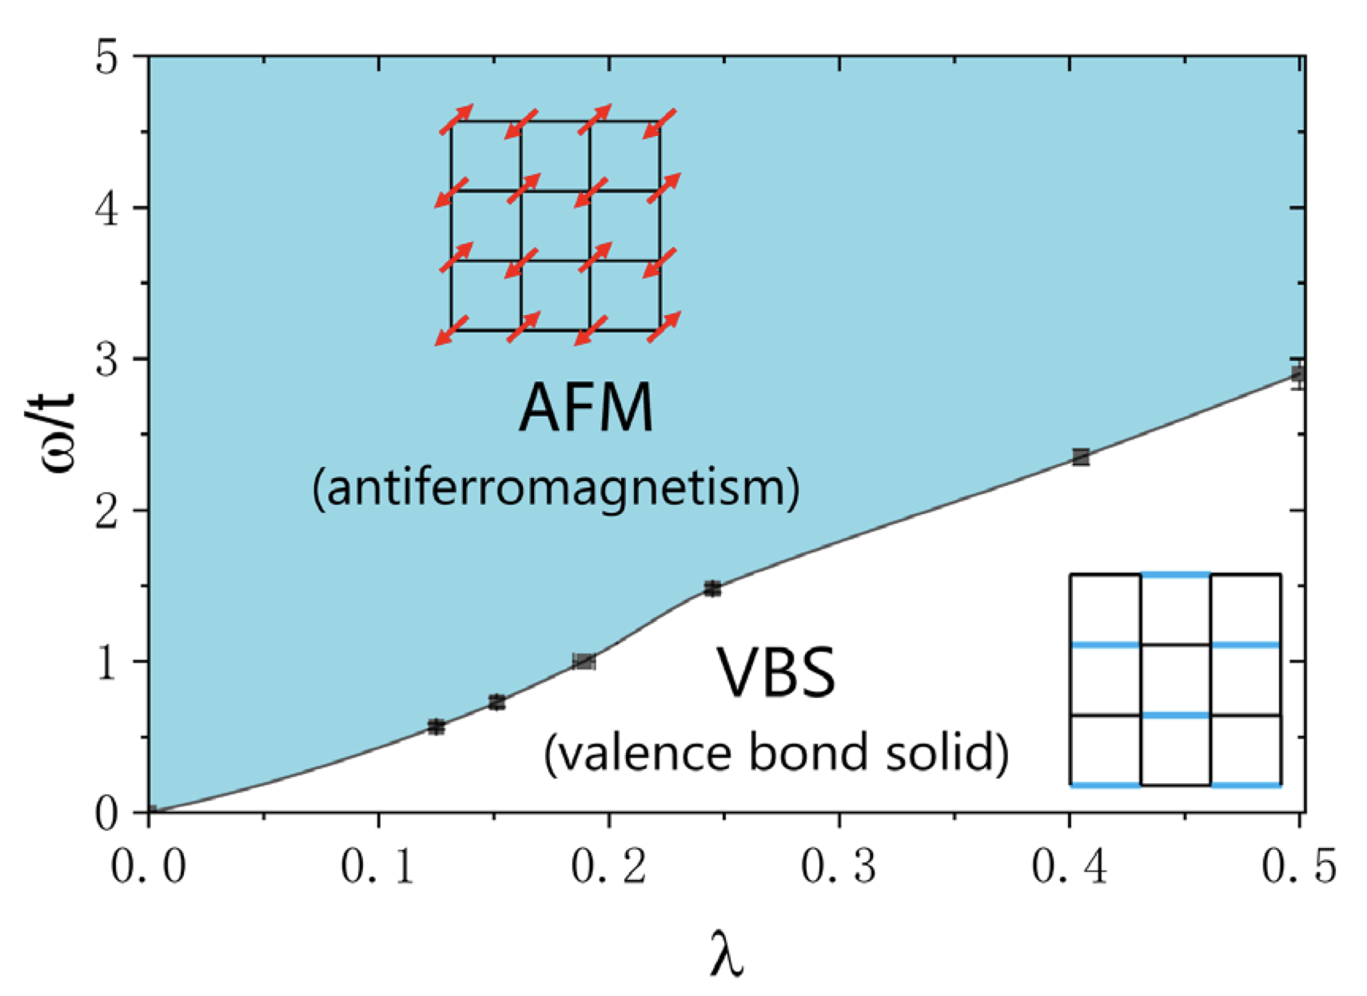
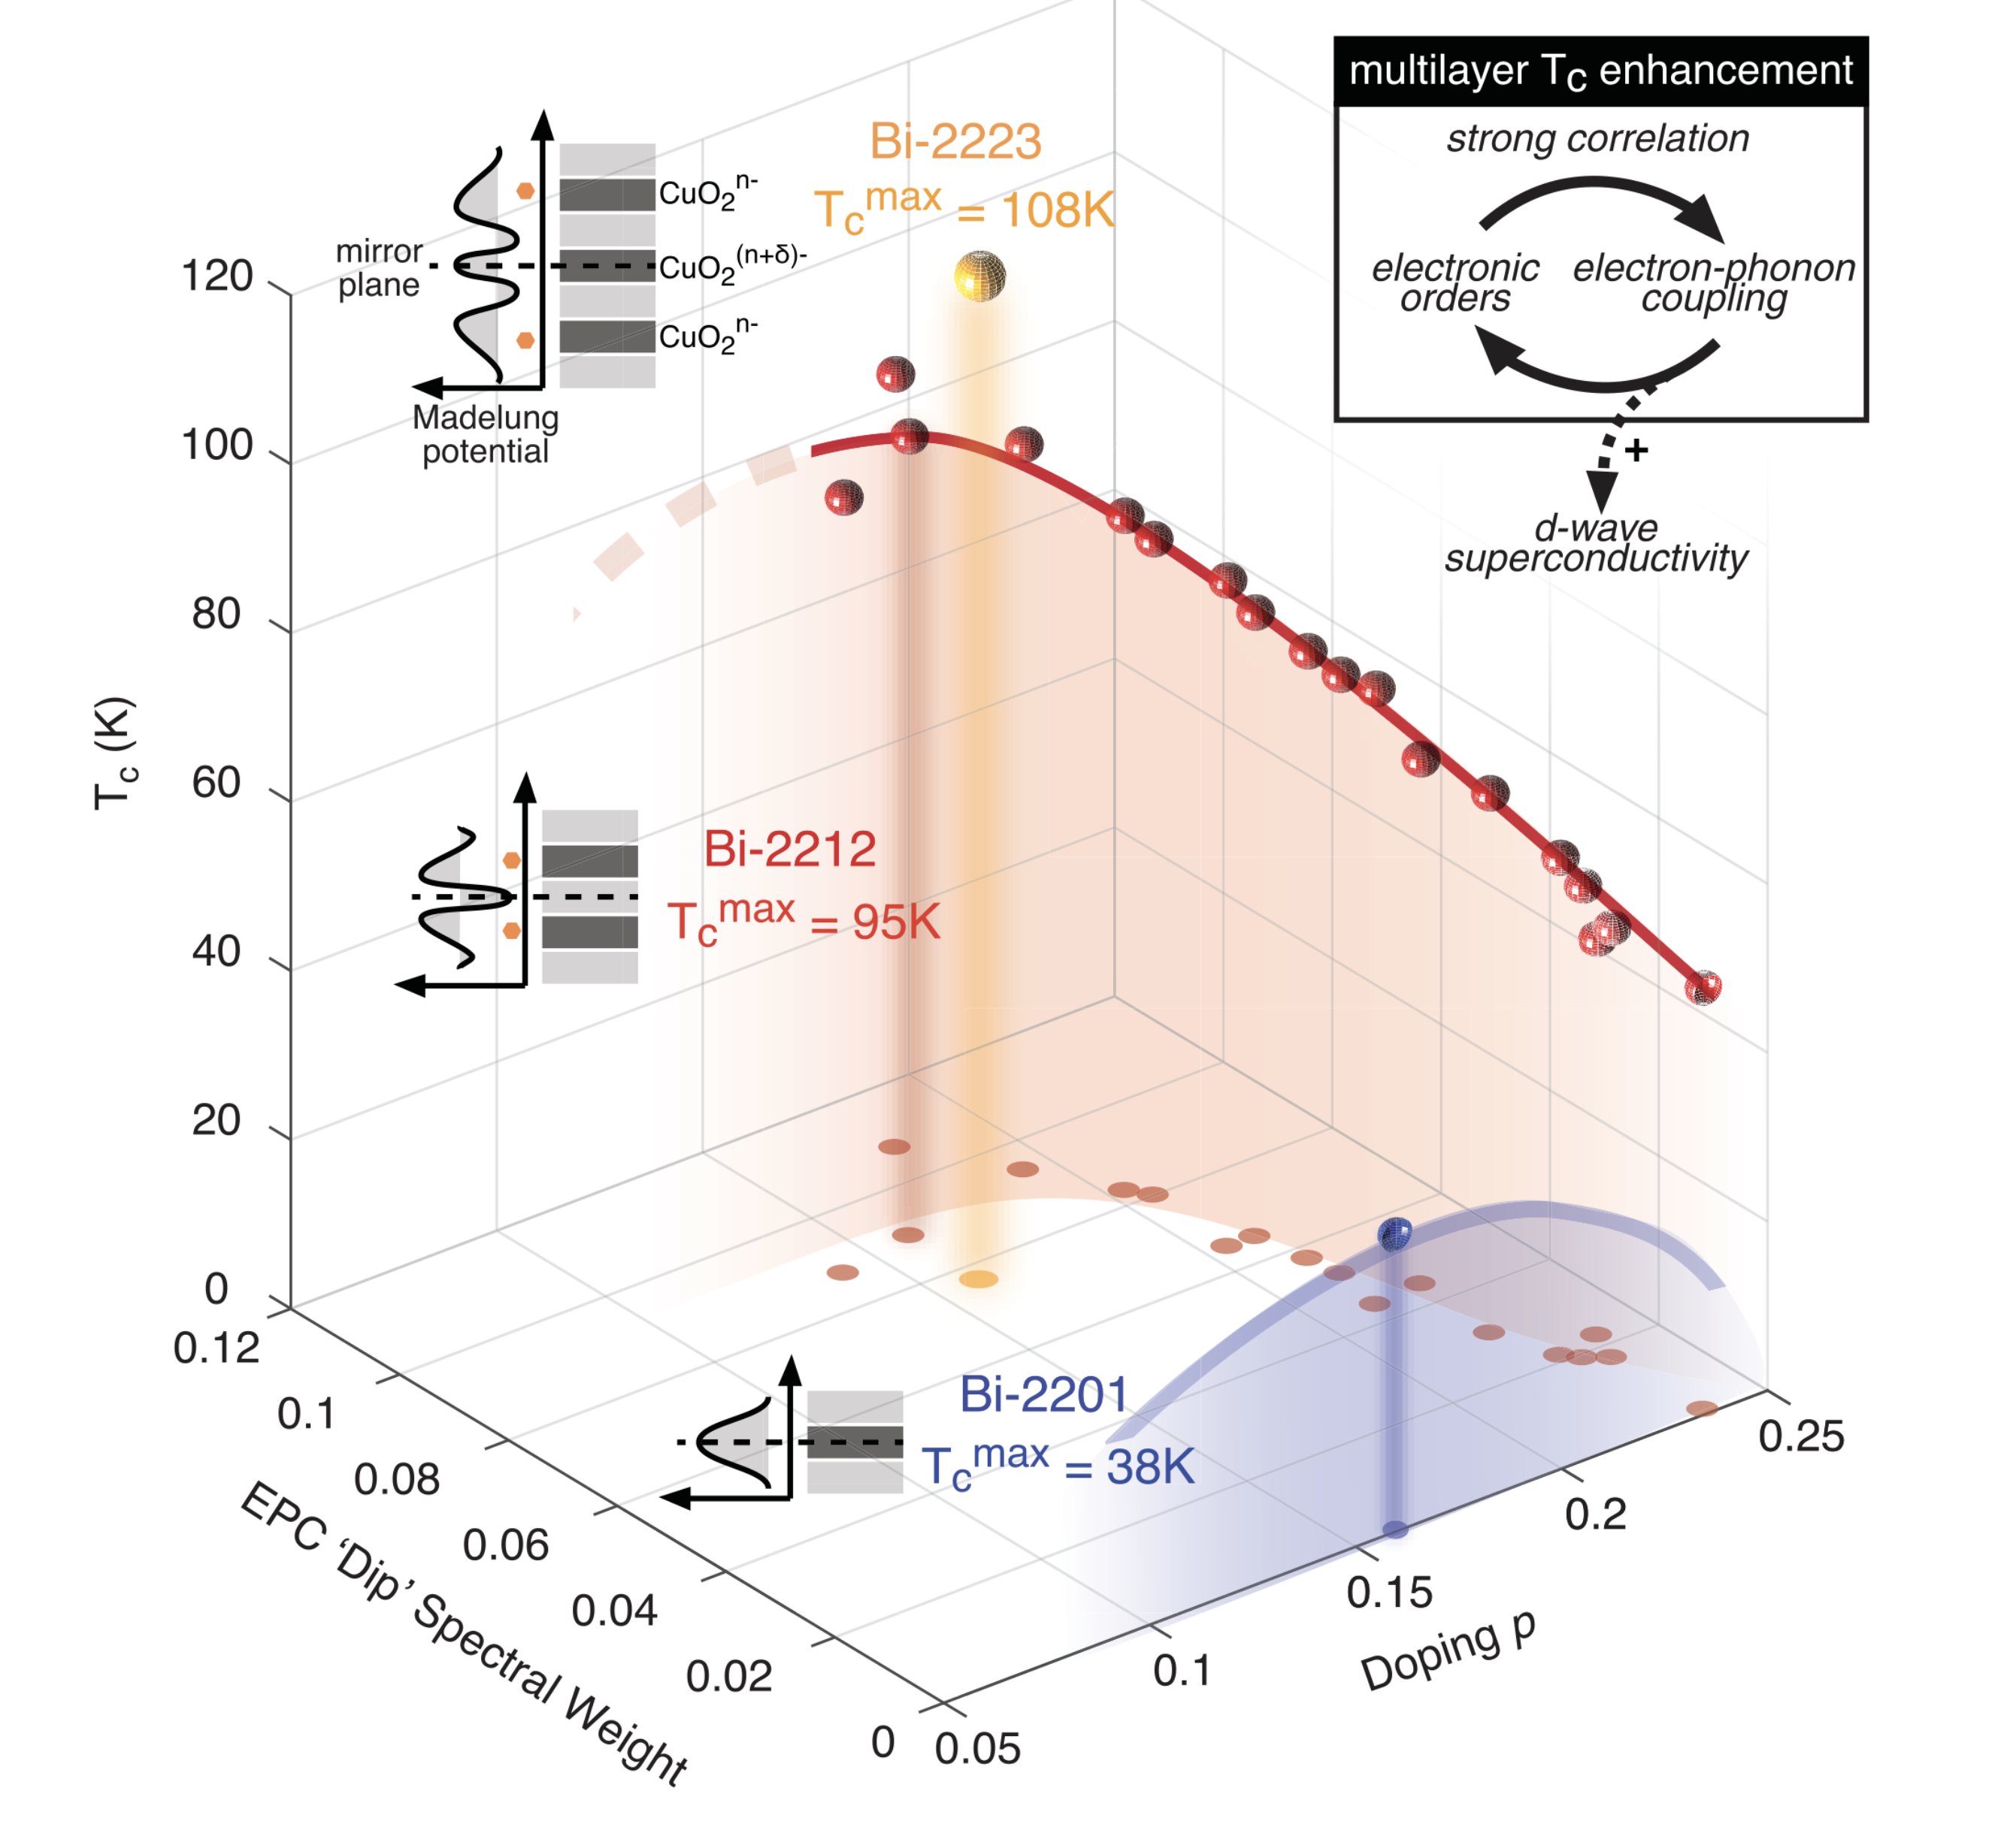
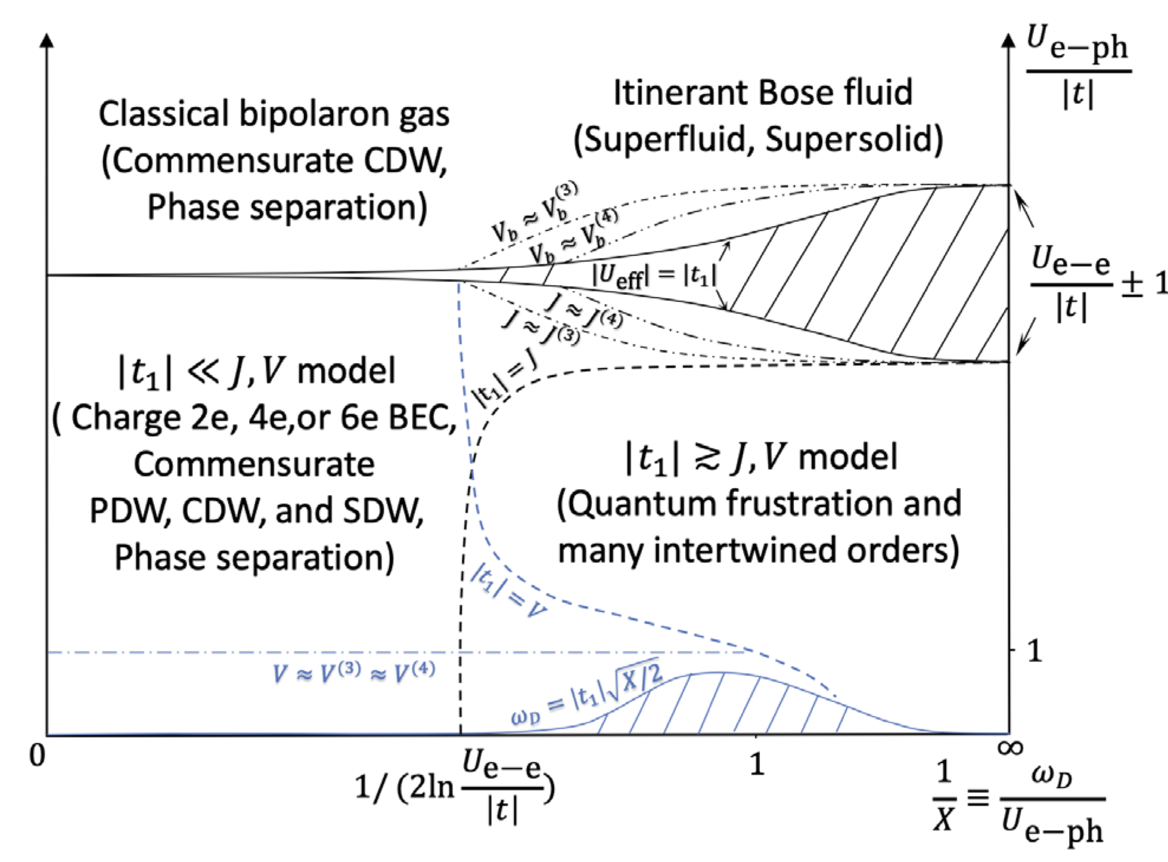
Today’s key role: electron-phonon coupling
Increasing experimental and theoretic researches indicate that EPC can be an essential ingredient in high-T_{c} superconductors, including cuprates and iron-based superconductors.
Phase diagram of the Su-Schrieffer-Heeger model at half-filling
Xun Cai, Zi-Xiang Li, and HY PRL (2021)
intertwined growth of the superconductivity and EPC
[Y. He, Z.-X. Shen et al.,Science (2018)]
Z. Han, S. A. Kivelson, and HY, PRL (2020).
Notes:
EPC drives the formation of Cooper pairs in conventional superconductivity.

Slide 6
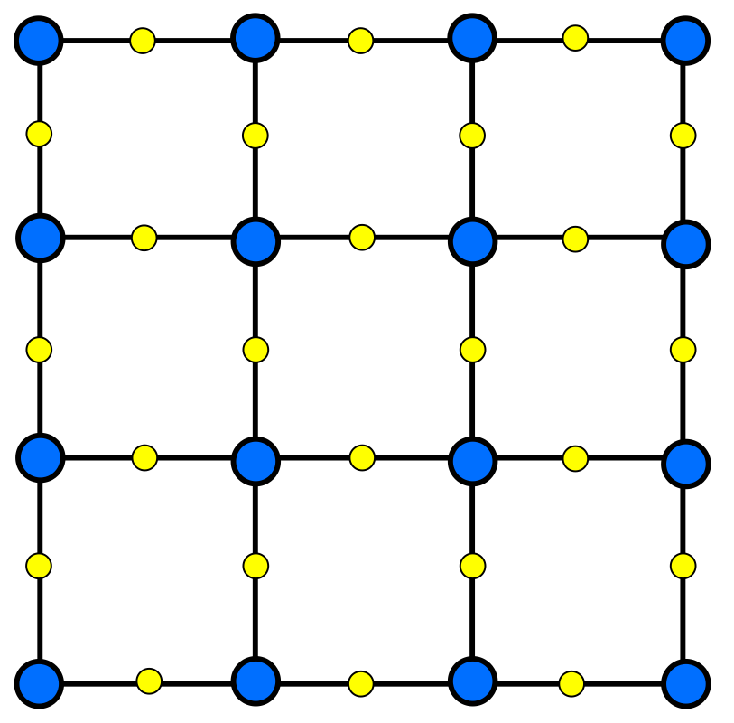
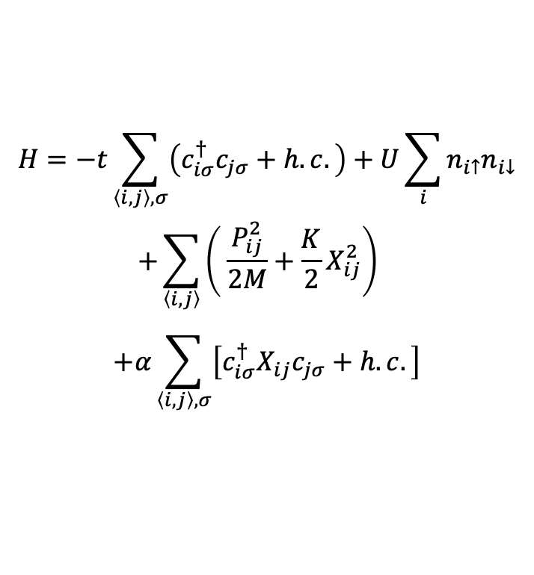
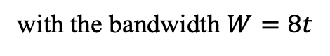
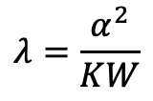
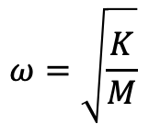
The Su-Schrieffer-Heeger-Hubbard model
The Hamiltonian of SSHH model:
$$H=−t\sum_{\left\langle i,j\right\rangle ,σ}{\left(c_{iσ}^{†}c_{jσ}+h.c.\right)}+U\sum_{i}{n_{i↑}n_{i↓}}$$
$$+\sum_{\left\langle i, j\right\rangle }{\left( \frac{P_{ij}^{2}}{2M}+\frac{K}{2}X_{ij}^{2}\right)}$$
$$+α\sum_{\left\langle i, j\right\rangle ,σ}{\left[c_{iσ}^{†}X_{ij}c_{jσ}+h.c.\right]}$$
$$ω=\sqrt{\frac{K}{M}}$$
Phonon frequency:
electron site
phonon site
The dimensionless EPC constant:
$$λ=\frac{α^{2}}{KW}$$
The model might be relevant to the physics of CuO₂ plane considering B_{1g} phonons.
with the bandwidth $W=8t$
Xun Cai, Zi-Xiang Li, and HY, PRL (2021)

Slide 7
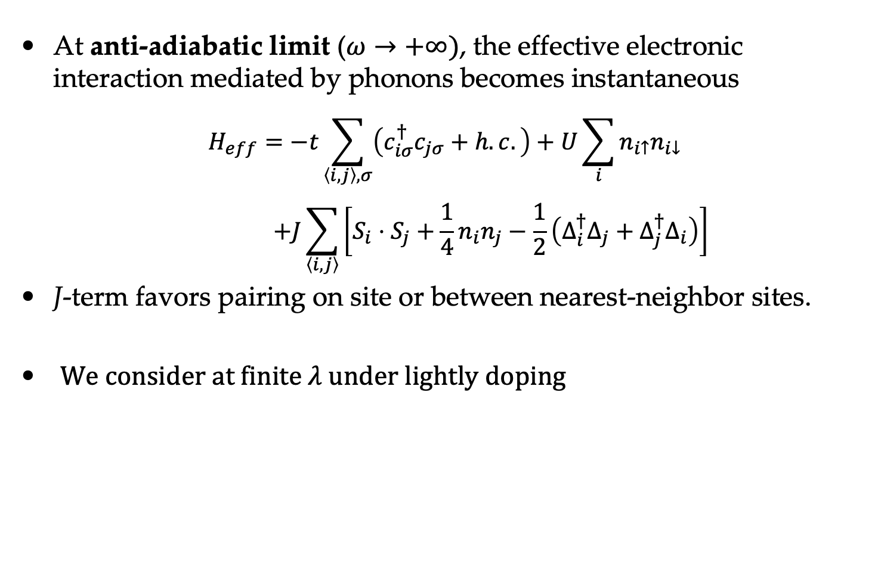
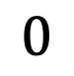
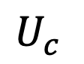
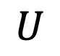

Limit analysis
At anti-adiabatic limit ($ω→+∞)$, the effective electronic interaction mediated by phonons becomes instantaneous
$$H_{eff}=−t\sum_{\left\langle i,j\right\rangle ,σ}{\left(c_{iσ}^{†}c_{jσ}+h.c.\right)}+U\sum_{i}{n_{i↑}n_{i↓}}$$
$$+J\sum_{\left\langle i, j\right\rangle }{\left[S_{i}⋅S_{j}+\frac{1}{4}n_{i}n_{j}−\frac{1}{2}\left(Δ_{i}^{†}Δ_{j}+Δ_{j}^{†}Δ_{i}\right)\right]}$$
J-term favors pairing on site or between nearest-neighbor sites.
We consider at finite 𝜆 under lightly doping
$$J=\frac{2α^{2}}{K}=2λW$$
$$0$$
$$U$$
$$U_{c}^{}$$
d-wave SC ?
BCS, s-wave SC

Slide 8
Method: Density Matrix Renormalization group (DMRG)

Slide 9
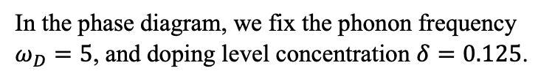
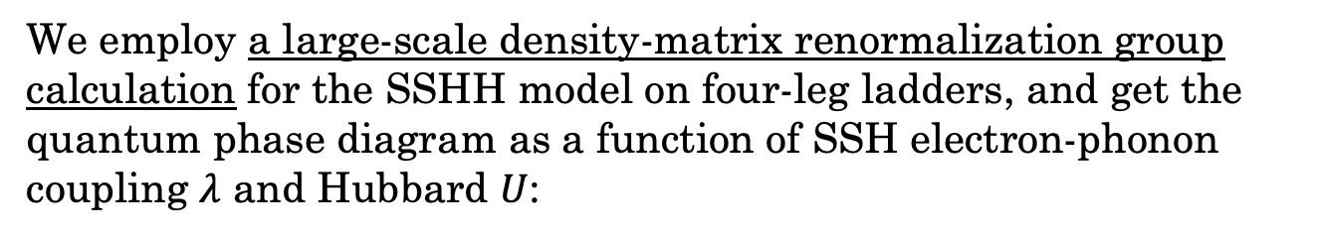
Phase Diagram
We employ a large-scale density-matrix renormalization group calculation for the SSHH model on four-leg ladders, and get the quantum phase diagram as a function of SSH electron-phonon coupling $λ$ and Hubbard $U$:
s-wave SC phase: dominant quasi-long-range on-site SC correlation and subdominant quasi-long-range charge density correlation;
stripe CDW phase: short-range SC correlation and long-range CDW ordering;
d-wave SC phase: dominant SC correlation with d-wave symmetry and subdominant charge-density correlation;
In the phase diagram, we fix the phonon frequency $ω_{D}=5$, and doping level concentration $δ=0.125$.

Slide 10
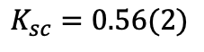
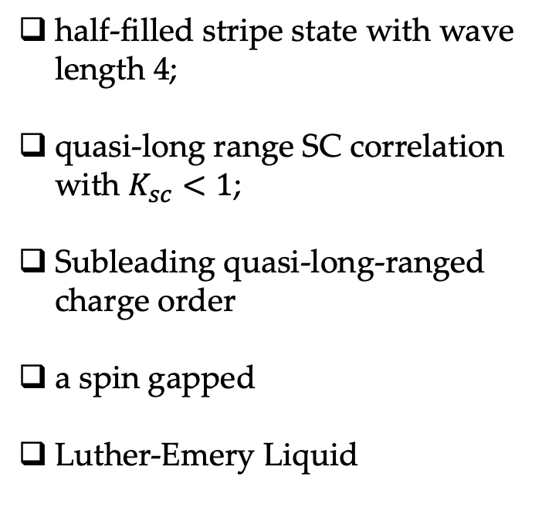

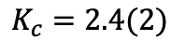
s-wave state for finite $λ$ and 𝑼=𝟎 (𝜆=0.3)
half-filled stripe state with wave length 4;
quasi-long range SC correlation with $K_{sc}<1$;
Subleading quasi-long-ranged charge order
a spin gapped
Luther-Emery Liquid
(b)
(c)
$$K_{c}=2.4(2)$$
$$K_{sc}=0.56(2)$$
(d)
Notes:
Charge density profile on Lx = 48
superconductivity correlation
charge density correlation
spin correlation

Slide 11
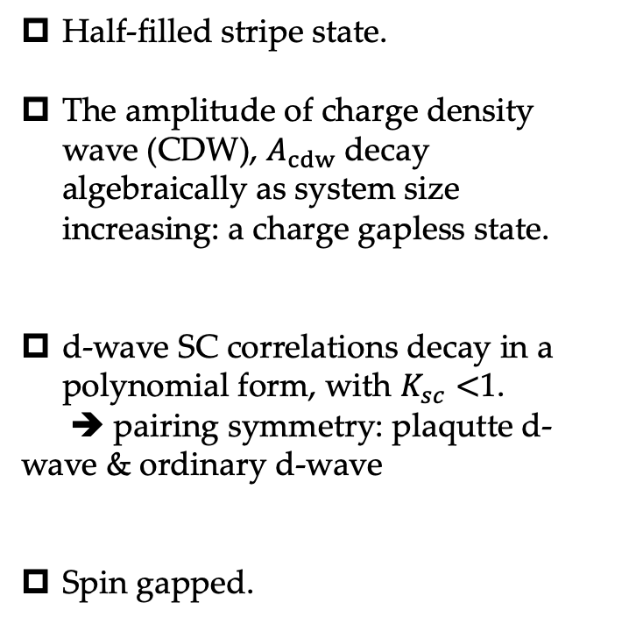
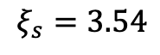
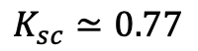
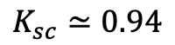
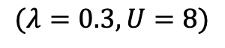
d-wave state for moderate EPC and 𝑼
$$(λ=0.3, U=8)$$
Half-filled stripe state.
The amplitude of charge density wave (CDW), $A_{cdw}$ decay algebraically as system size increasing: a charge gapless state.
d-wave SC correlations decay in a polynomial form, with $K_{sc}<$1.
➔ pairing symmetry: plaqutte d-wave & ordinary d-wave
Spin gapped.
$$K_{sc}≃0.94$$
$$ξ_{s}=3.54$$
$$K_{sc}≃0.77$$
Notes:
The wave length of charge density is $4$, so-called half-filled stripe state.
The amplitude of charge density wave (CDW), $A_{cdw}$ decay algebraically as system size increasing, indicating a charge gapless state.
(d), (e), SC correlation on Lx=32 cylinder

Slide 12
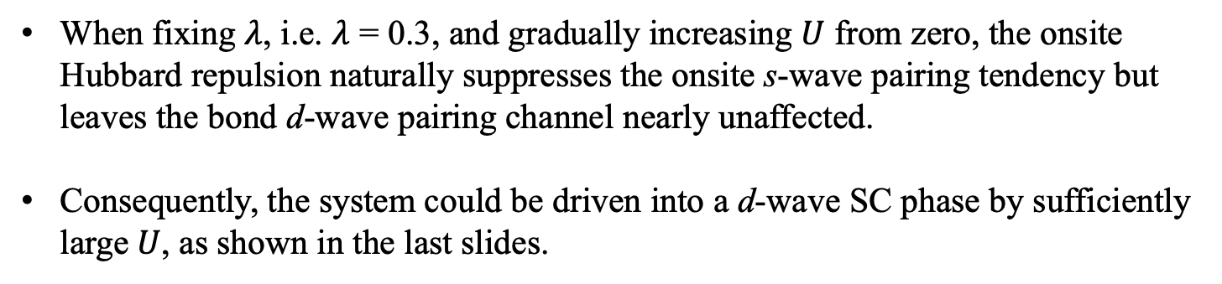

SC evolution from s-wave to d-wave
s-wave pairing
d-wave pairing
$$U$$
When fixing $λ$, i.e. $λ$ = 0.3, and gradually increasing $U$ from zero, the onsite Hubbard repulsion naturally suppresses the onsite s-wave pairing tendency but leaves the bond d-wave pairing channel nearly unaffected.
Consequently, the system could be driven into a d-wave SC phase by sufficiently large$U$, as shown in the last slides.

Slide 13
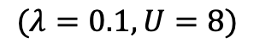
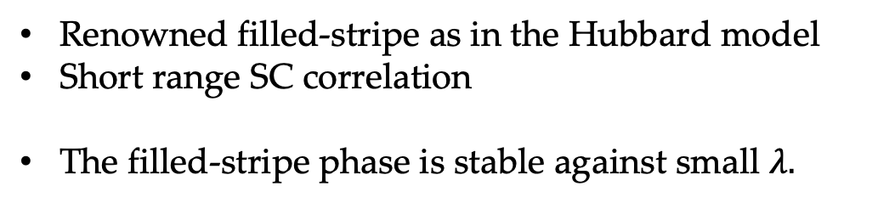
stripe state
$$(λ=0.1, U=8)$$
Renowned filled-stripe as in the Hubbard model
Short range SC correlation
The filled-stripe phase is stable against small $λ.$

Slide 14
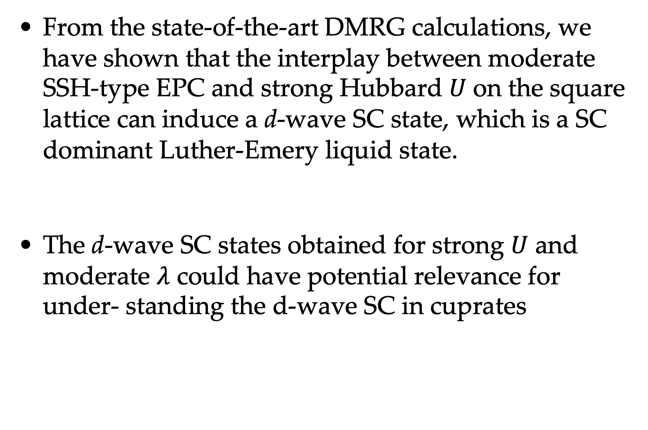
Conclusions
From the state-of-the-art DMRG calculations, we have shown that the interplay between moderate SSH-type EPC and strong Hubbard 𝑈 on the square lattice can induce a d-wave SC state, which is a SC dominant Luther-Emery liquid state.
The d-wave SC states obtained for strong $U$ and moderate $λ$ could have potential relevance for under- standing the d-wave SC in cuprates
Thank you for your attention!

